Slide 1
Erasmus+ Latvia 2023

Slide 2
Wood processing industry and school work experience in school workshops

Slide 3
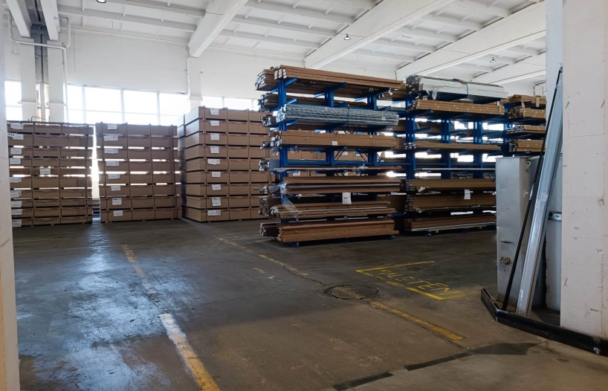
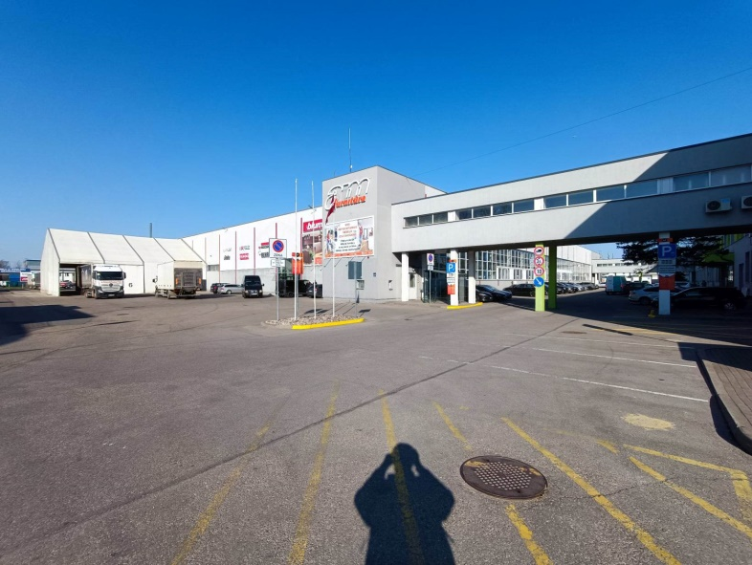
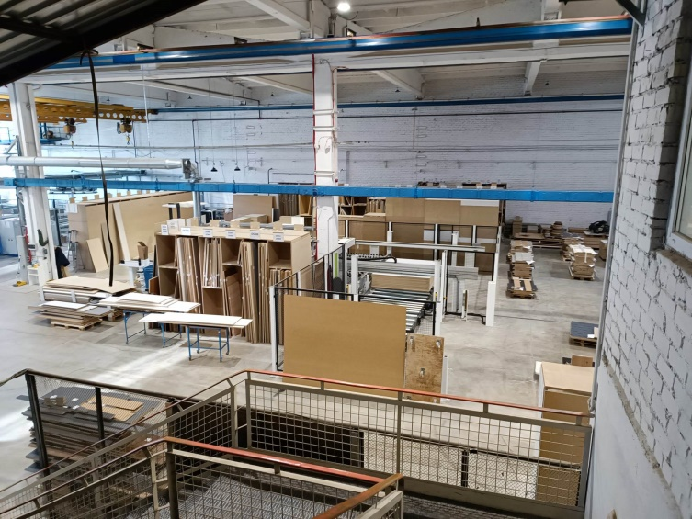
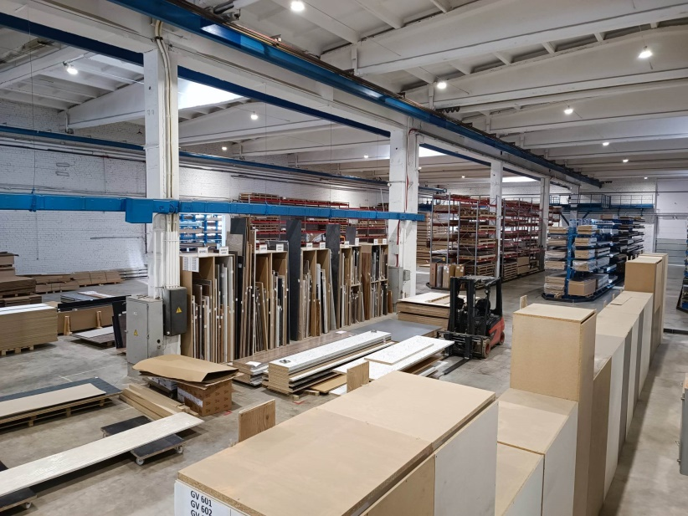
AM Furnitúra
My work : I watched how someone worked and wrote down the time for how long an operator did the work.

Slide 4
Attending schools in Riga
First school: Riga State Technical University, Press Center
- I sat in on a Latvian class.
Second school: Riga Technical college
- Finally, I had experience work in a workshop.
Third school: Technical school of arts and media in Riga
- Quite interesting. Before I went to technical college in Chotěboř, I had wanted to become an artistic joiner.

Slide 5
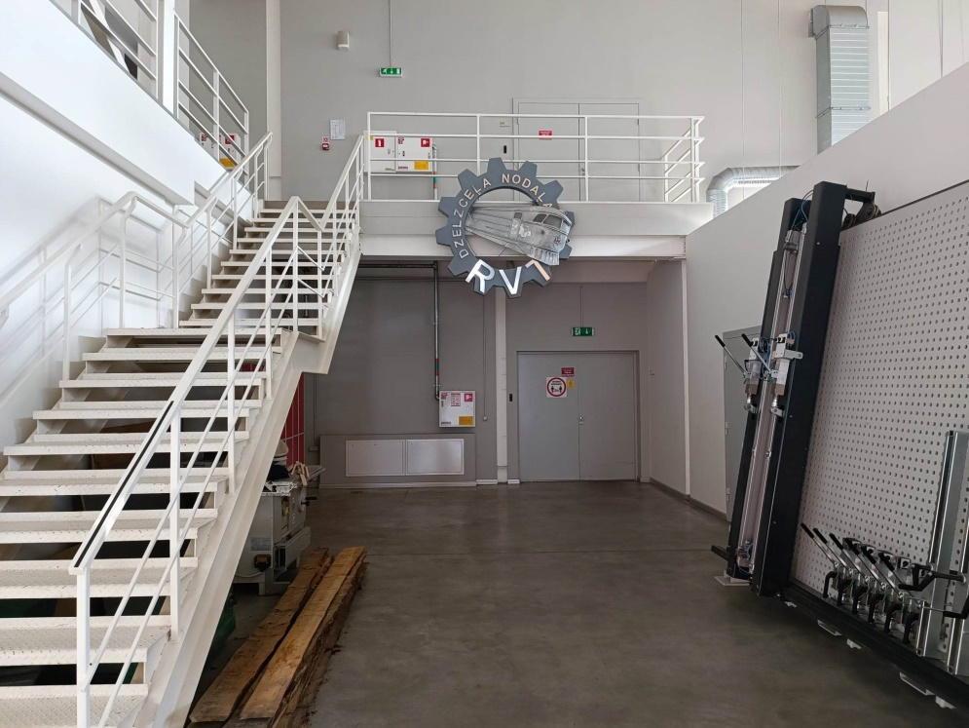
First school in Riga

Slide 6
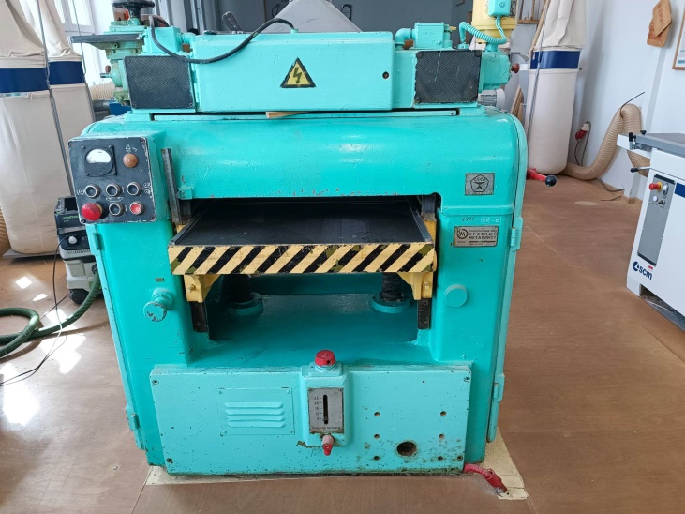
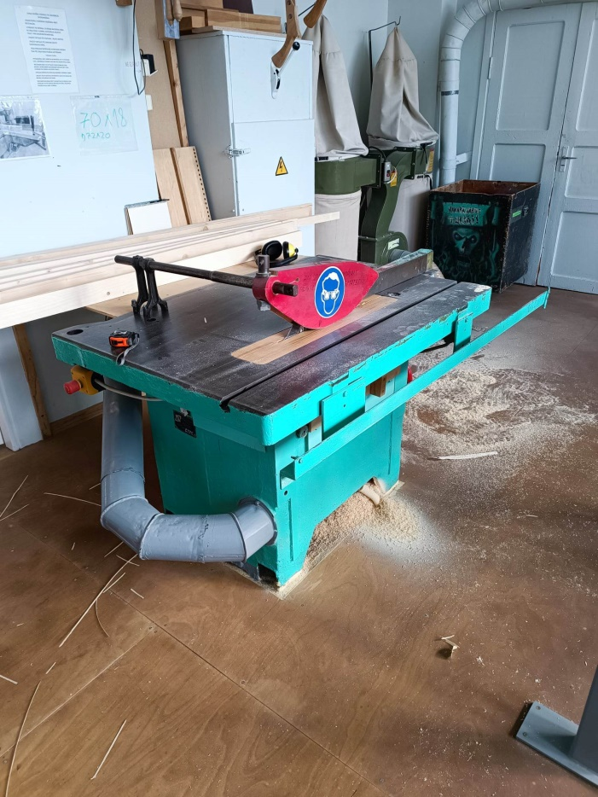
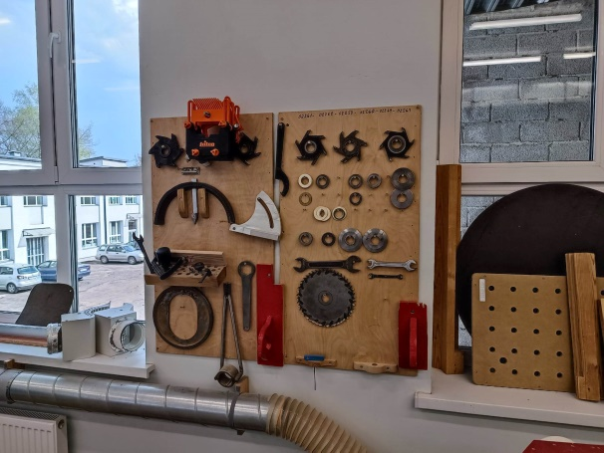
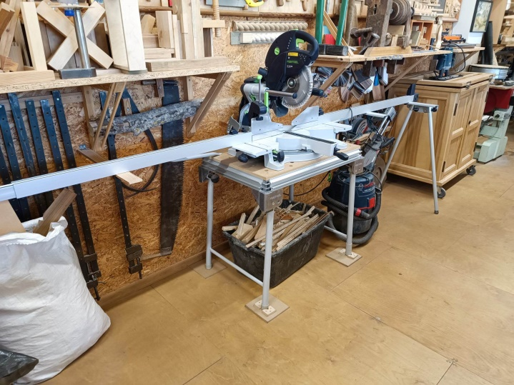
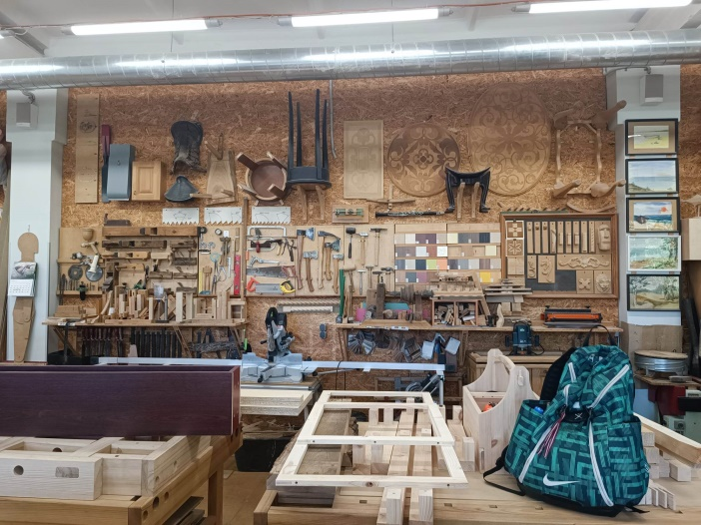
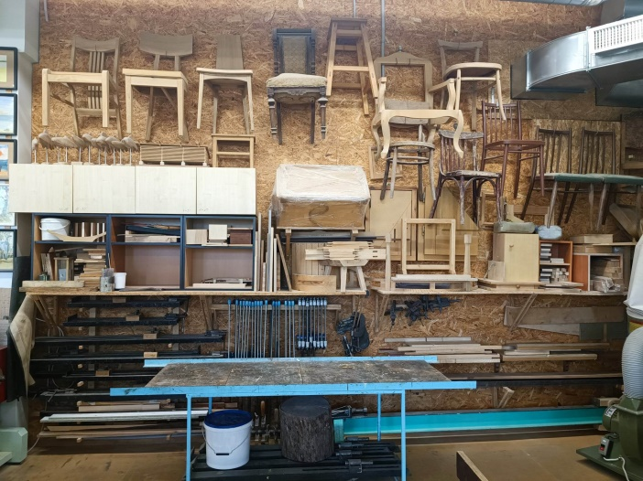
2nd school

Slide 7
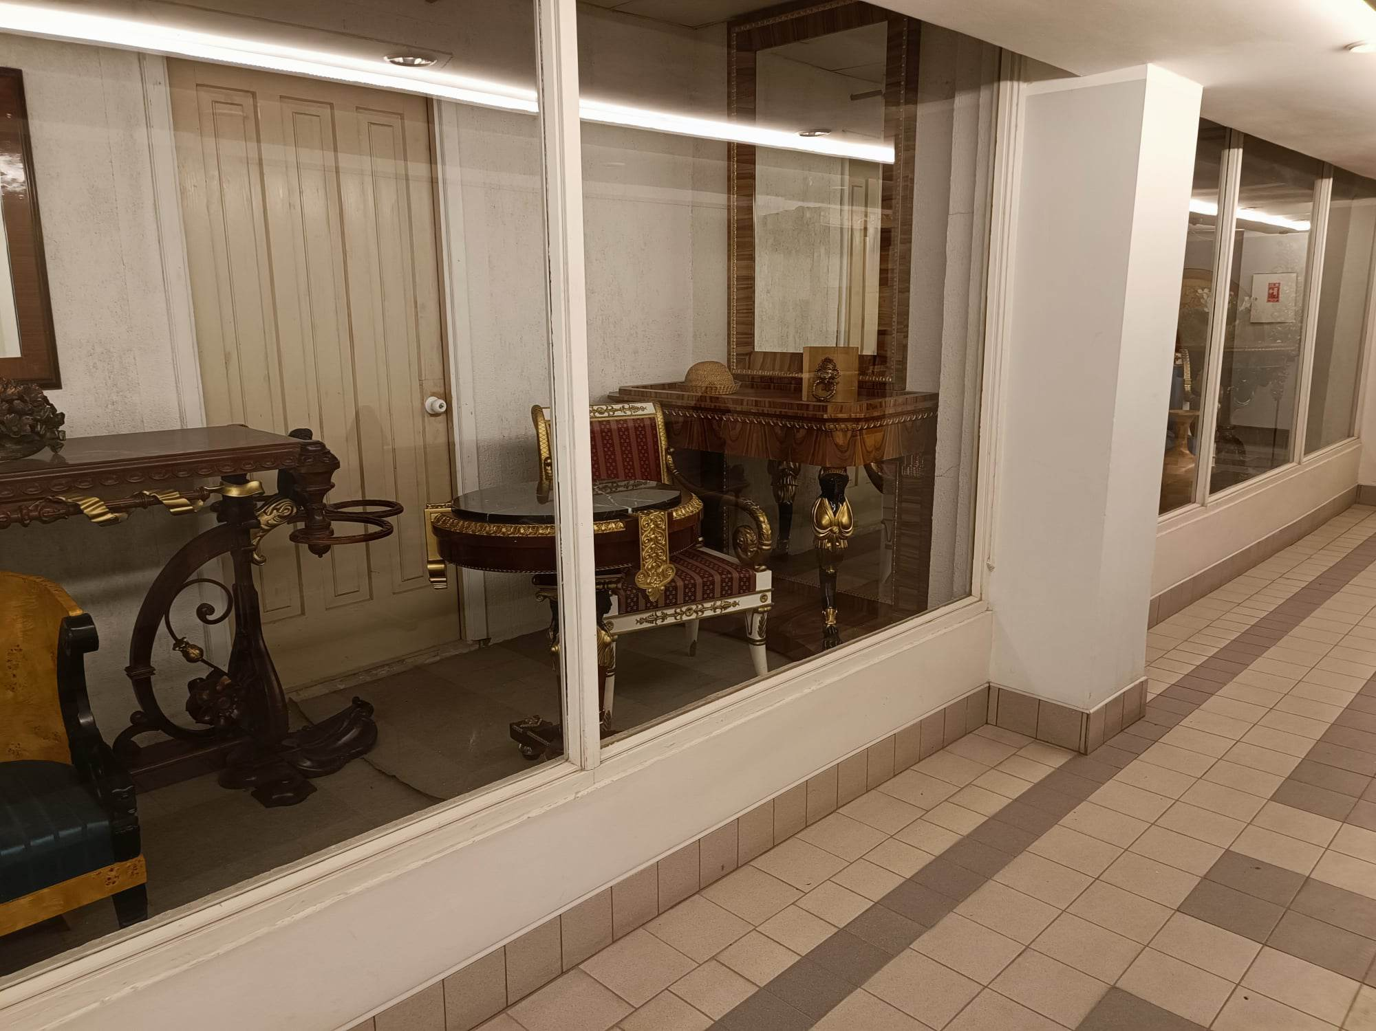
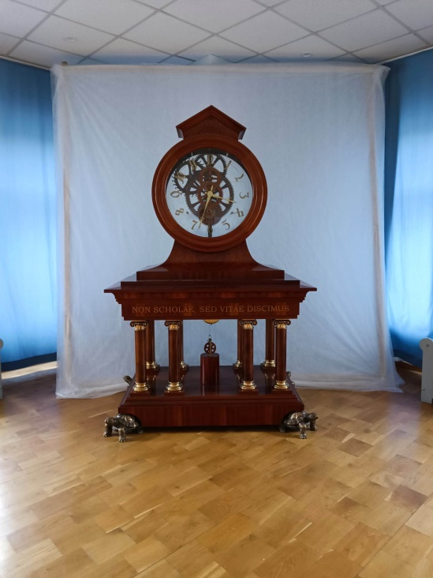
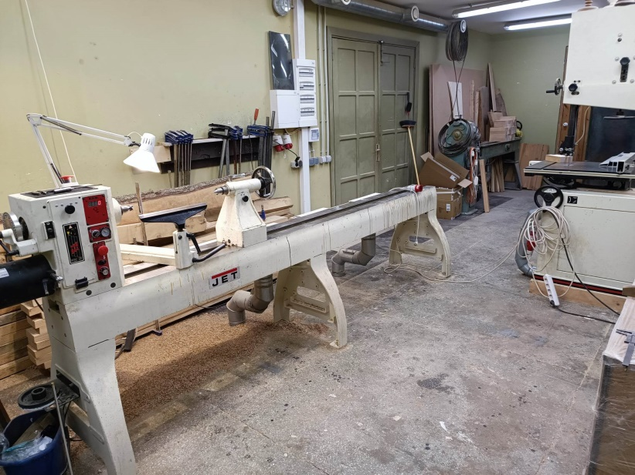
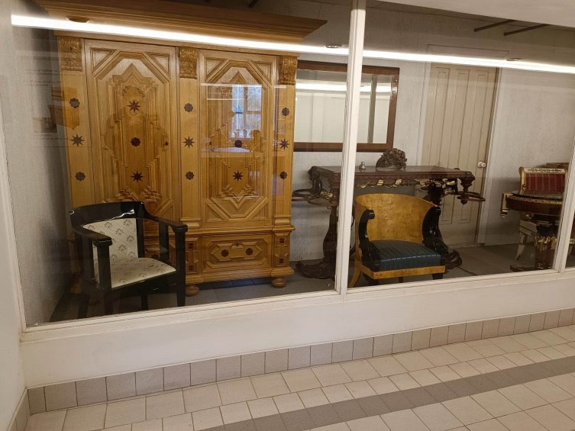
3rd school

