Slide 1



Erasmus+
Latvia 2023

Slide 2
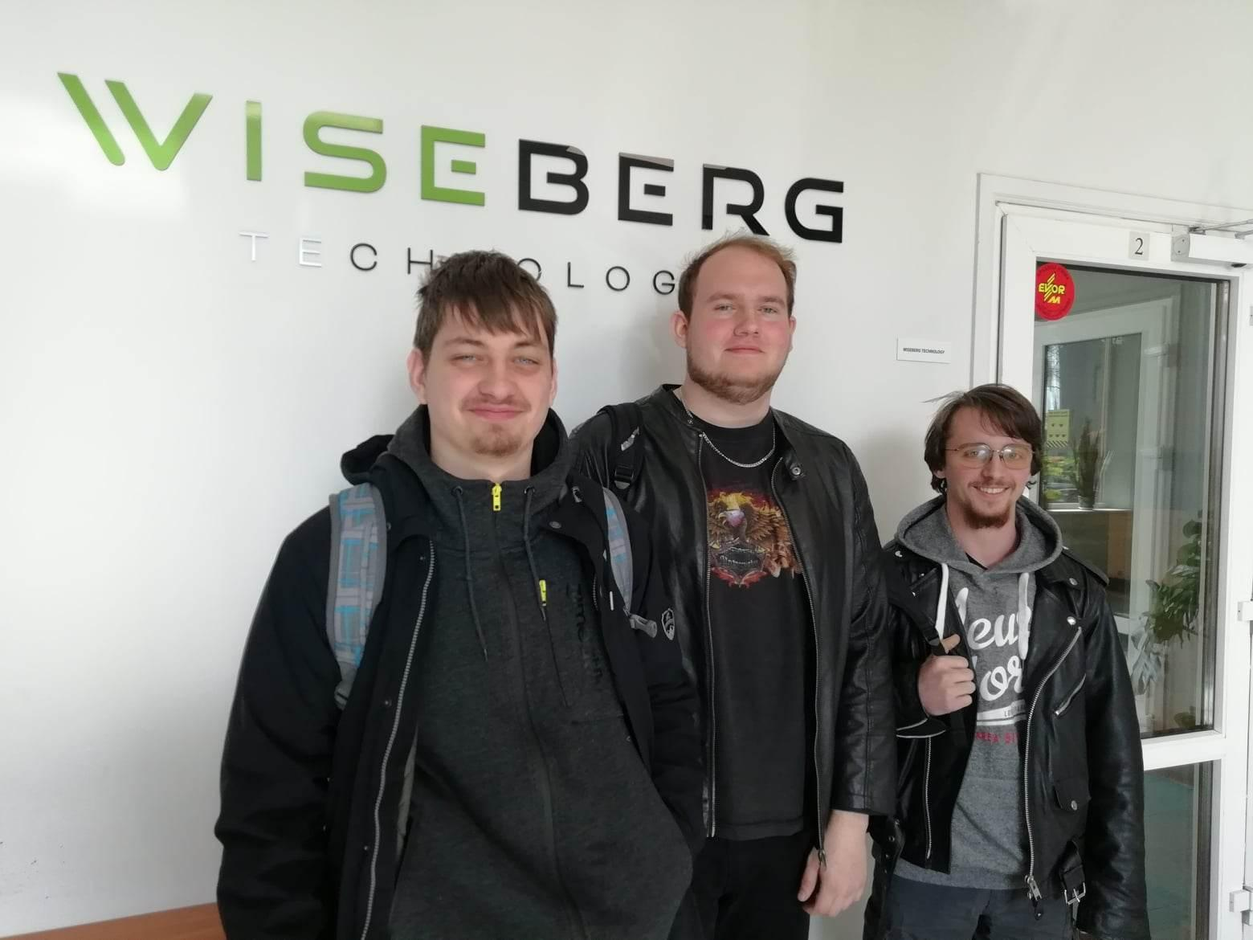
Wiseberg Technology
PCB (Printed Circuit Board) design
PCB programming and testing
Creating of prototypes
Wire crimping

Slide 3
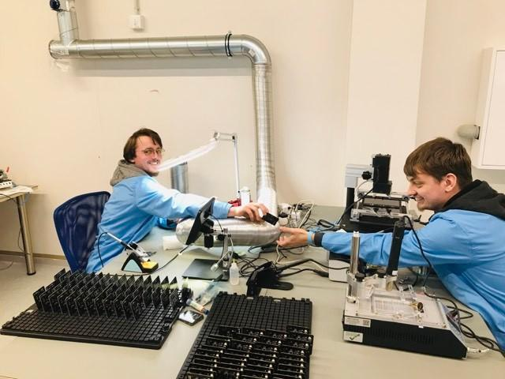
Our Work
Soldering
Attaching stickers
Stocktaking

