Slide 1
Erasmus+ Latvia 2023

Slide 2
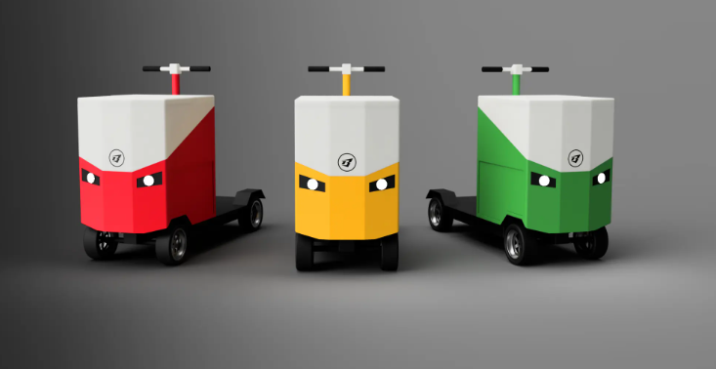
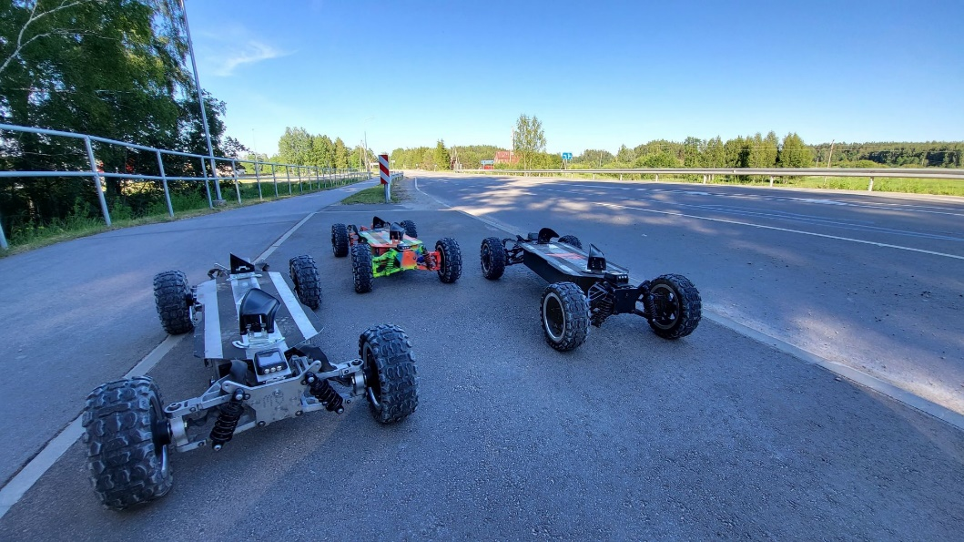
runtor
Start-up
The company has three employees
They make cargo scooters and electric skateboards
Cargo scooters
Electric skateboards

Slide 3
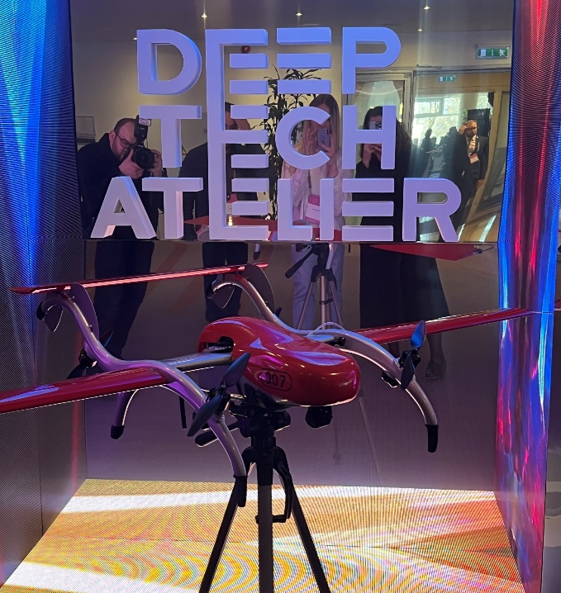
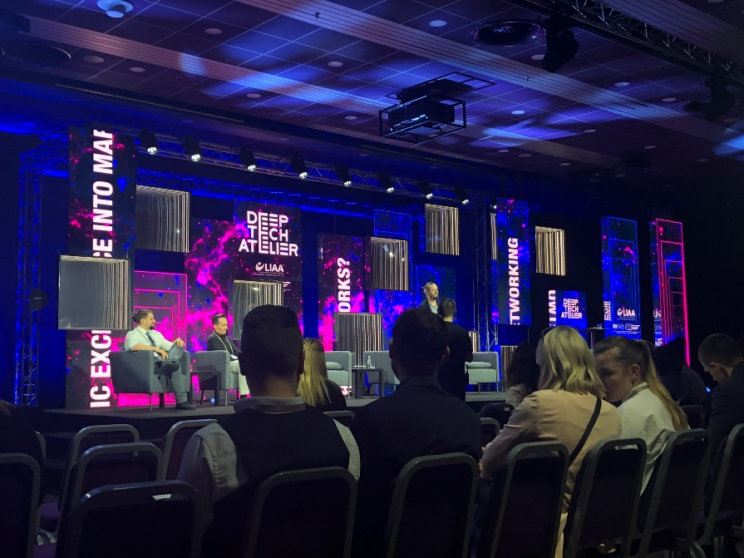
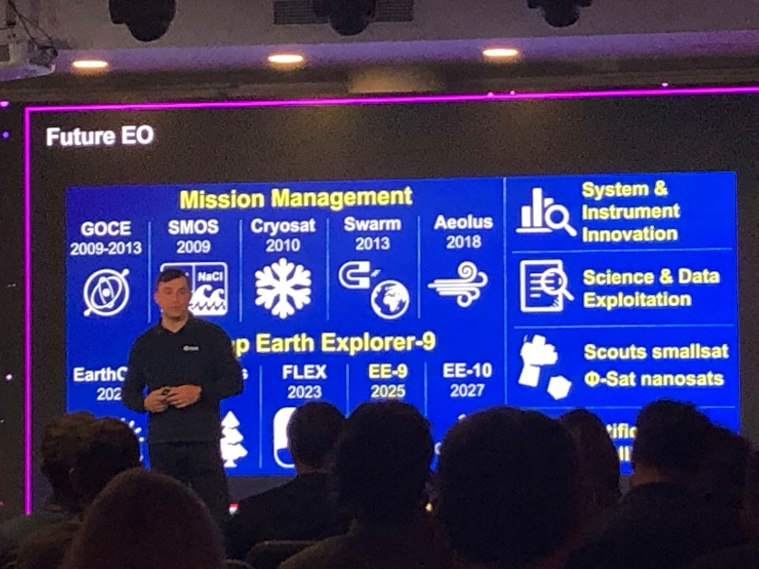
Our Work
In Bruntor, we mainly conducted market research in Europe.
Gathering information on companies within a given country: salaries, number of employees, etc.
Visiting conferences: Deeptech atelier and Fantodroms
Fixar drone
Open discussion
^{*1}EO – Earth Observation
^{*2}ESA – European Space Agency
Future EO by ESA

