Slide 1
Erasmus+ Latvia 2023

Slide 2
Facts about Riga and Latvia

Slide 3
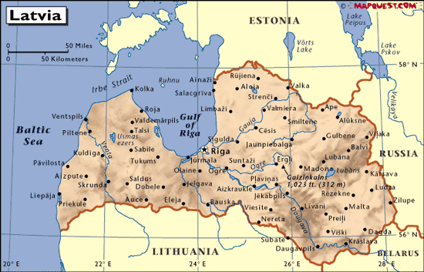
Location
Latvia is located in northern part of Europe above Lithuania
It’s one of the three Baltic states near the Baltic Sea

Slide 4
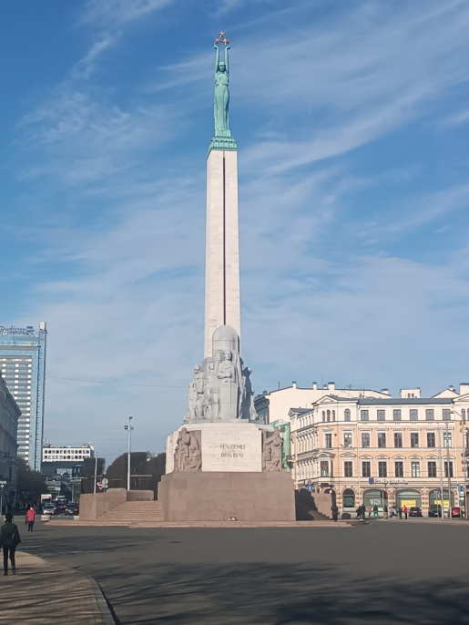
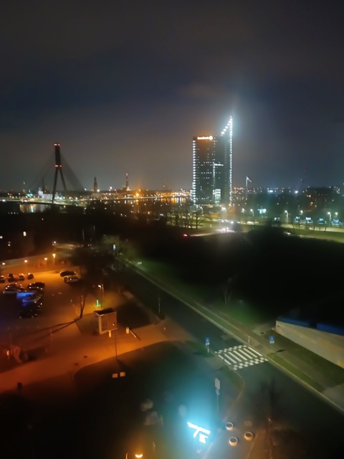
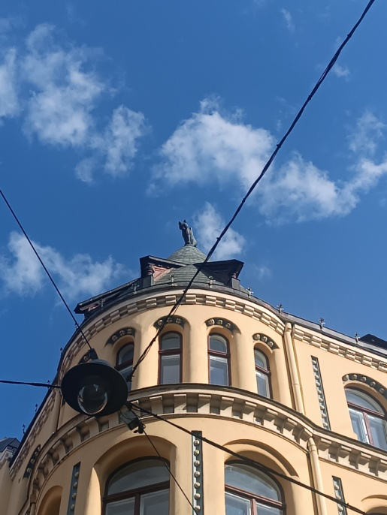
Riga
The capital city of Latvia
It has a population of 602,000 people
It has an interesting infrastructure
It feels like the Czech Republic

Slide 5
Travelling, Accommodation and Food

Slide 6
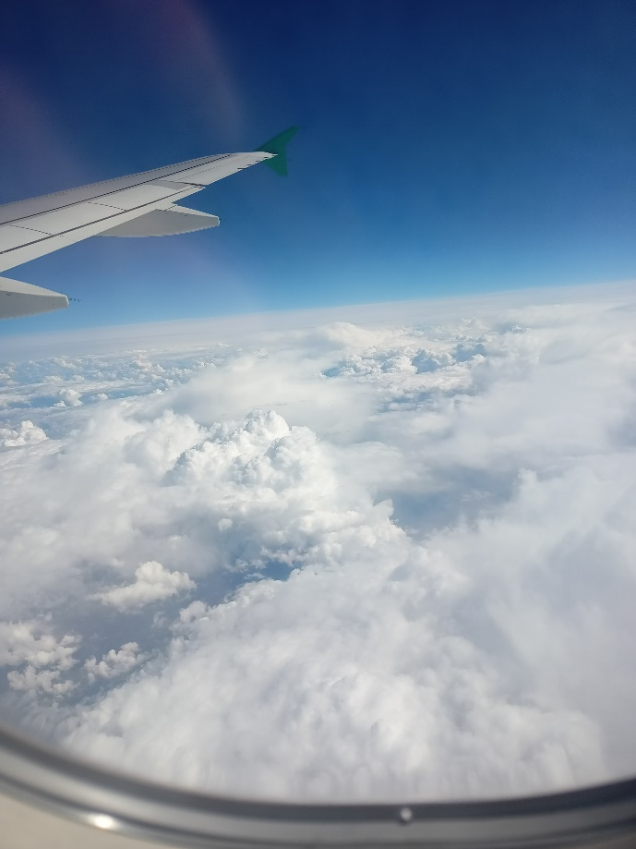
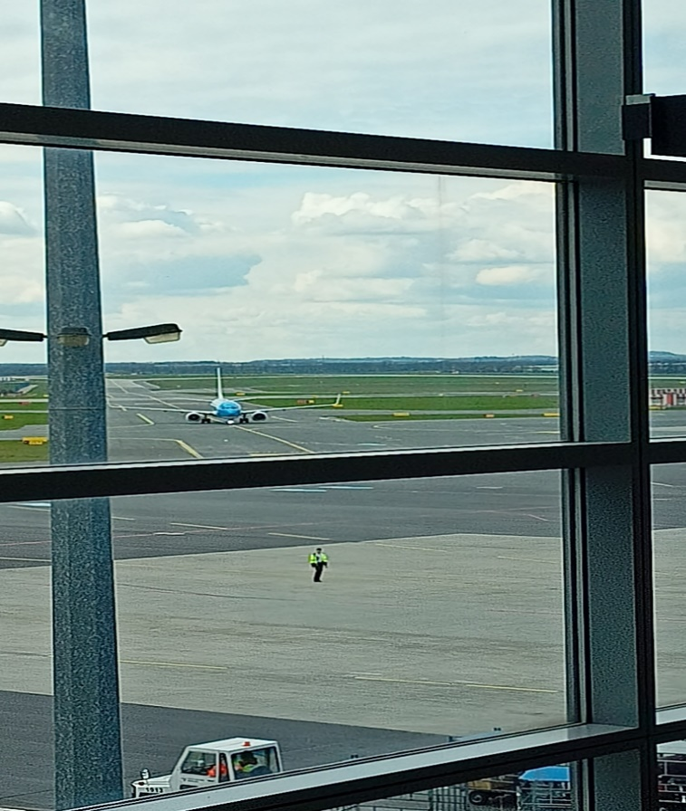
Travelling
16 April 2023 Departure from Prague to Riga
Welcomed by rainy weather in Riga
Public transport was used in Riga every day
28 April 2023 Departure from Riga to Prague

Slide 7
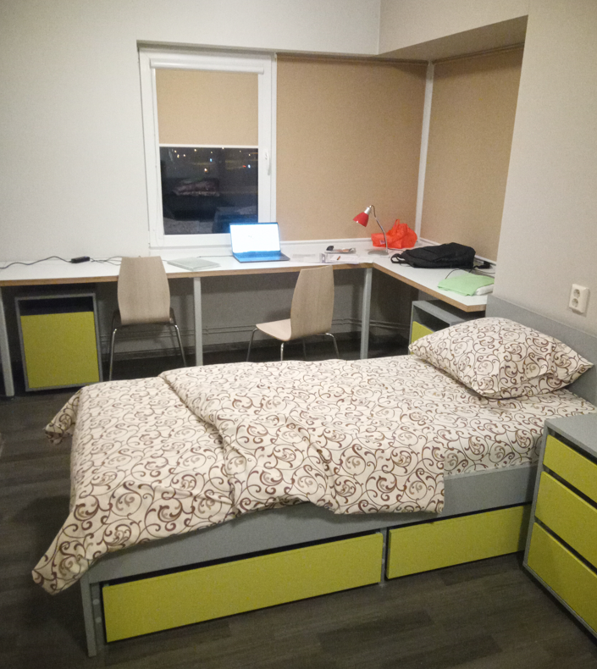
Accommodation
Dormitory of RTU (Riga Technical University)
Flats with 3 bedrooms, a shared kitchen and bathroom
Dinners usually in a university canteen

Slide 8
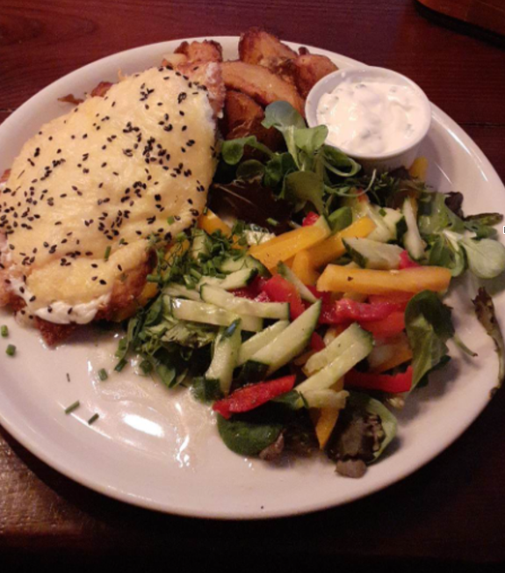
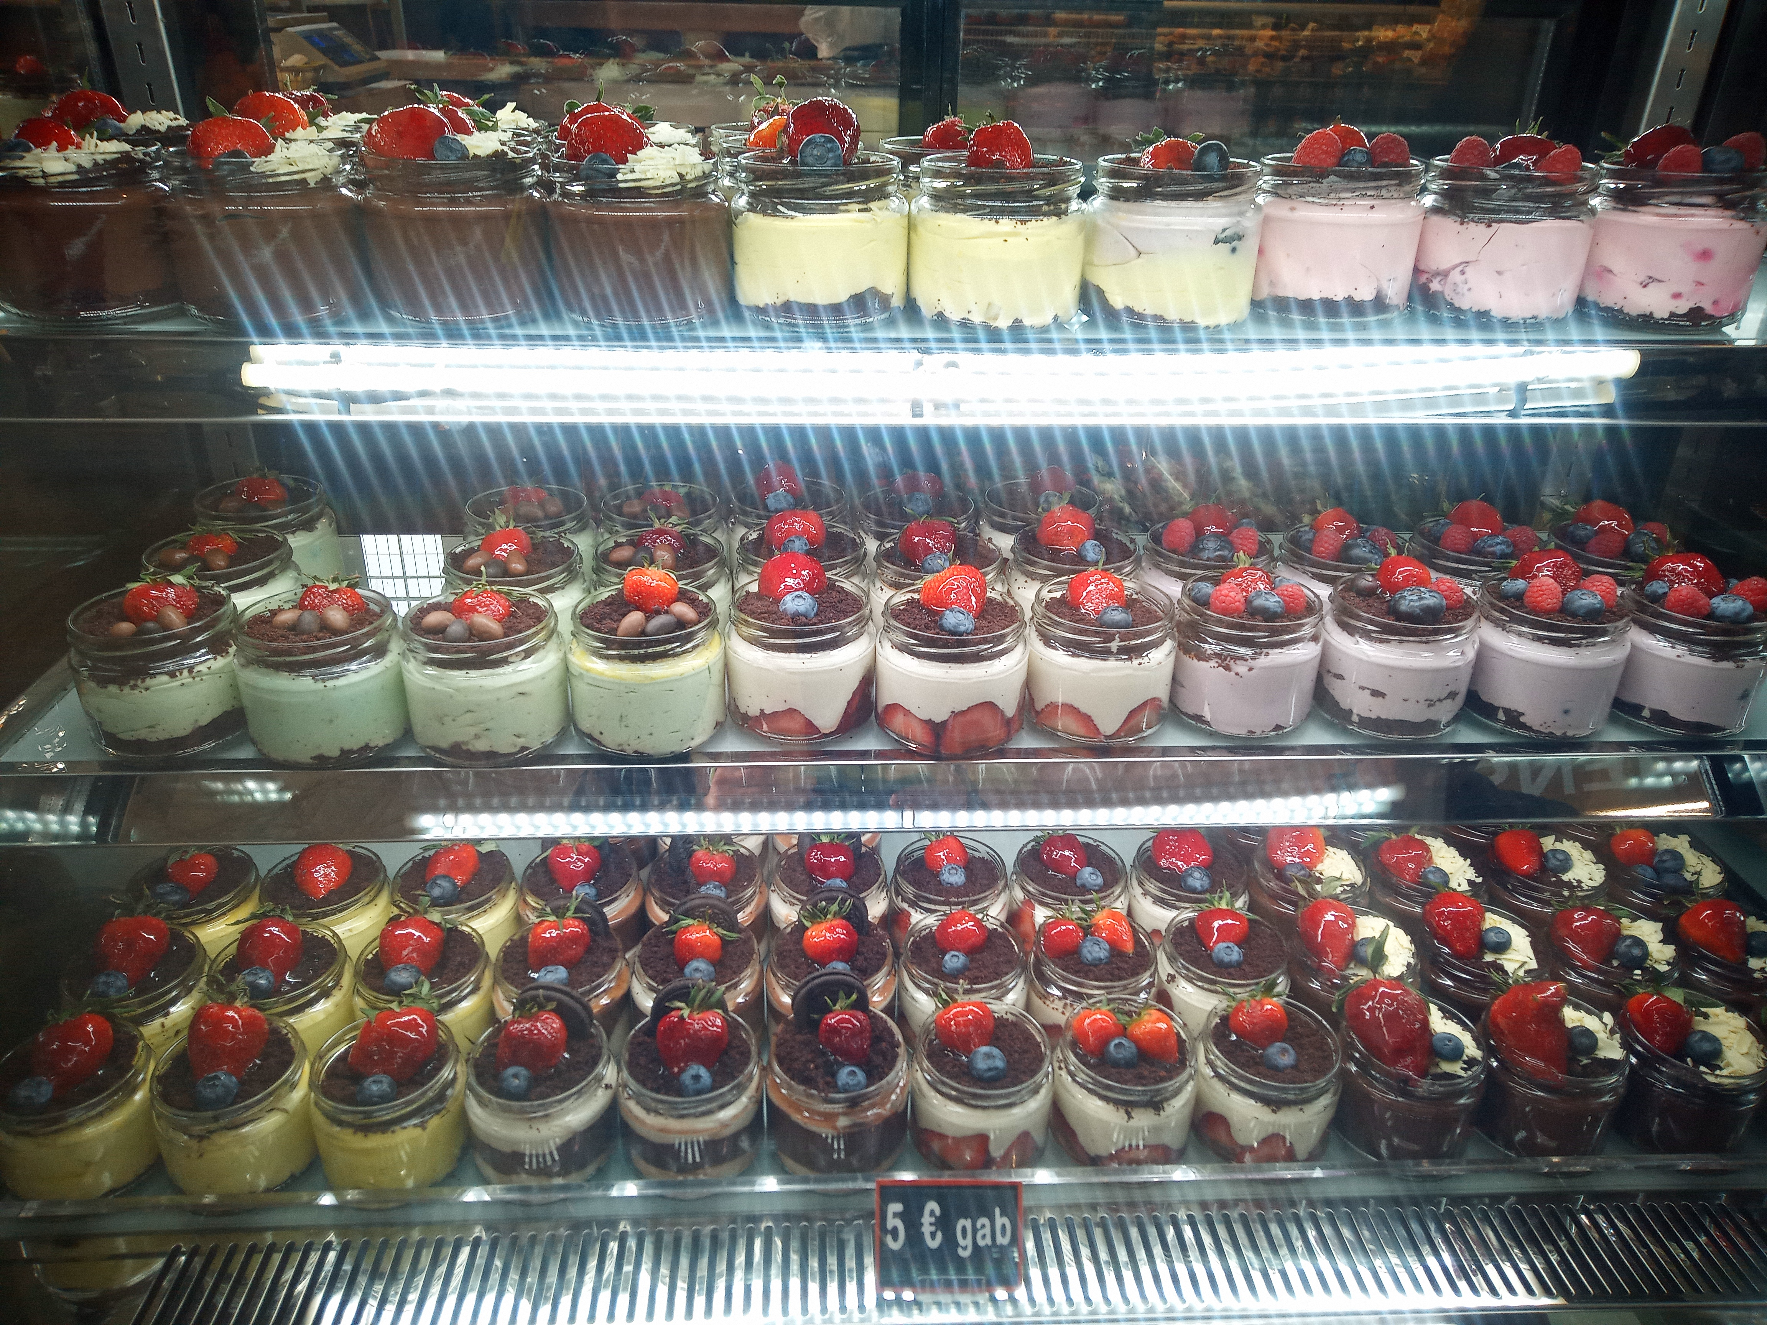
Food
In contrast to Czechia, less spices are used.
White creamy sauce is very popular.
Honestly, the food was pretty good.
If you like the food in the Czech Republic, you'll like it.
The desserts are delicious.
Notes:
19.05.2023
8
8
8

